Slide 1




Business plan
SleepOnTime
Group member: SIPENG WU
KEXIN LEI
XINYI ZHOU
HUIQING HUANG

Slide 2
Product Description
Chapter 1
Project overview
Introduction to the main functions
Innovations

Slide 3


Product Description
SleepOnTime is a software that provides sleep time monitoring for working people, students and other groups who need to sleep regularly.
It can restrict the use of specific software during sleeping hours, helping users to control the time they use their mobile phones at night to improve their sleep quality and develop a regular sleep routine.
The product will be developed using Kotlin as the development syntax and Android Studio as the development tool.

Slide 4

Restrict the use of other software for a specific period of time
Main Functions
Play sleep aid audio
Lockout time and duration statistics

Slide 5
Minimalist interface design
--Improves responsiveness to a certain extent
--Enhances the visual aesthetics by using solid colours to clearly reflect the main functions of the software
--Help users to quickly familiarise themselves with the interface and operation of the software.
innovations

Slide 6
Professional Sleep Aid Audio Library
--Provides a wide range of professional sleep-aid audio to meet the needs of different user groups
--Encourages the uploading of original sleep-aid audio by sleep-aid audio biographers
--Ensure the quality of sleep aid audio in the app from a professional perspective.
innovations

Slide 7
Analysis of domestic macro environment
Chapter2
MARKET ANALYSIS
Market pain point
Applications and Uses

Slide 8

Analysis of
Political
and
Legal Environment
domestic macro environment
Economic Environment
Social-cultural environment
Technical Environment

Slide 9
Market pain point
Sleep duration is generally insufficient
The need for sleep supervision is not being met
There are deficiencies in existing sleep software

Slide 10




Target Users
Applications and
Uses
Competitive Analysis
SWOT Analysis

Slide 11
TARGET USERS
Through the use of electronic devices to relax learning pressure, often all night playing mobile phone games, which leads to the second day of class didn't spirit
Always receive extra work information during sleep time
Insomnia and through the use of cell phones to relax, which increased the degree of insomnia
Couldn't control themselves in sleep without the use of electronic equipment
ELECTRONIC EQIOPMENT
USERS
People in Workplace
SLEEP
DISORDERS
STUDENTS

Slide 12


Competitive Analysis
SleepTown
Digital Wellbeing
Features: using to build the concept of urban encourage users to keep the habit of using mobile phones in the lock time
Advantages: mobile phone can be locked for a period of time
Weekness: requires the user to have certain self-discipline, otherwise unable to reach the purpose of supervision and sleep
Features: allow the user to set a time limit for the application, the program automatically shut down after the time limit
Advantages: comprehensive management function, integration in the Android system, without having to install other applications, support parents control function
Weekness: some functions need to be enabled in the Settings, for users are not familiar with operation difficult

Slide 13



Analysis
Too strict locking function
Accuracy
Privacy protection
Fierce market competition
Control time
Know how long users sleep
Simple interface
All-purpose app
s
W
O
T
T
The entry and development of competitors
customer churn
Changes in policies and regulations
Improve
Develop
Improve brand awareness and attract more users

Slide 14
Overall marketing strategy
Chapter 3 Marketing analysis
4PS marketing Strategy

Slide 15
Overall marketing strategy
The marketing strategy of this project is to attract consumers to use this product through a combination of online web platform, new-media channels and various offline promotions, together with independent technology and customer-oriented quality service.

Slide 16



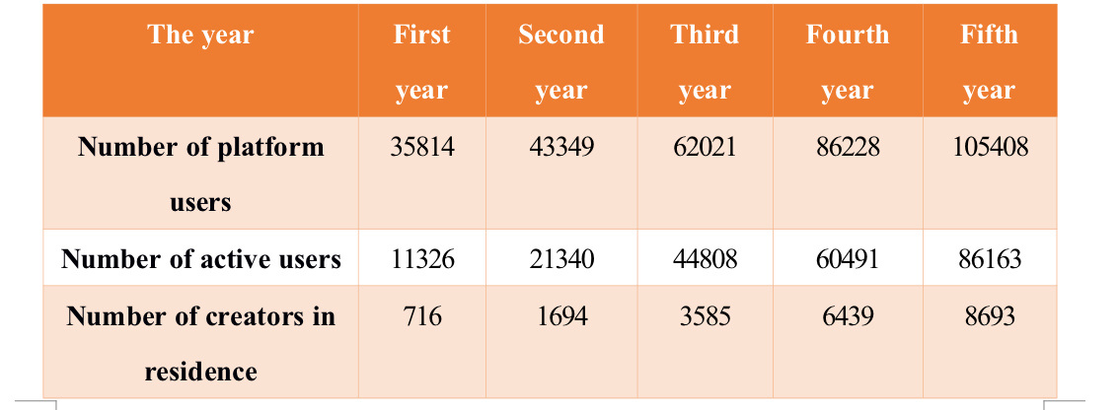
Marketing objectives
Table 3-1 Forecast for number of SleepOnTime product users

Slide 17
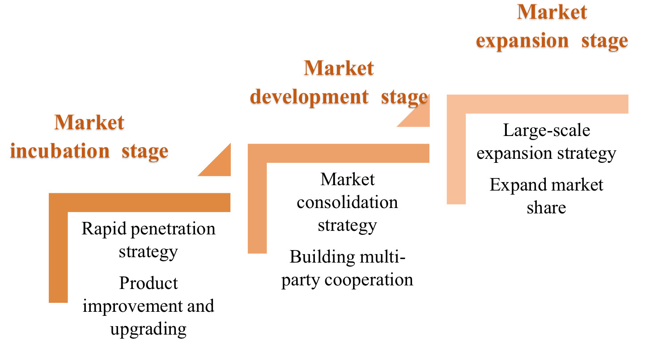
Market development stage and marketing strategy
Figure 3-2 SleepOnTime development stage and marketing strategy

Slide 18
Product Strategy
Marketing Strategy
Brand strategy
Price strategy
Publicity Strategy

Slide 19
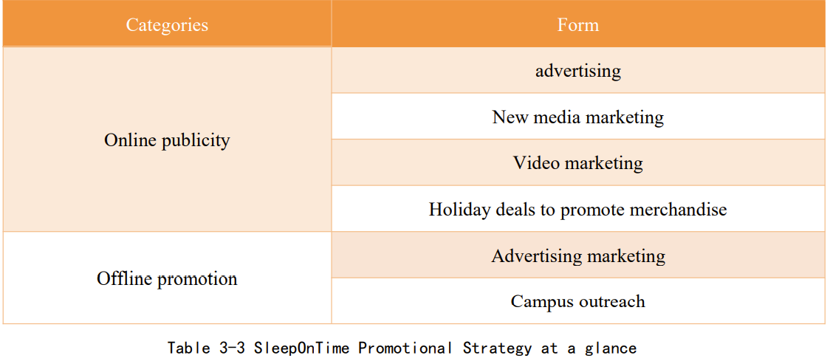
Publicity Strategy

Slide 20
Chapter 4 Development Planning
Development Planning

Slide 21
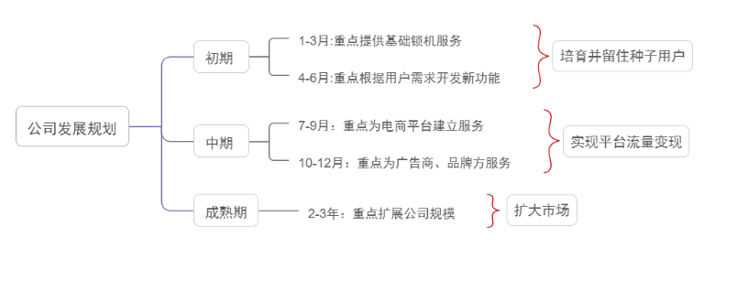
Specific development plan

Slide 22
Product Investment Forecast
Chapter 5
Financial
analysis
Revenue and User Volume Projections

Slide 23
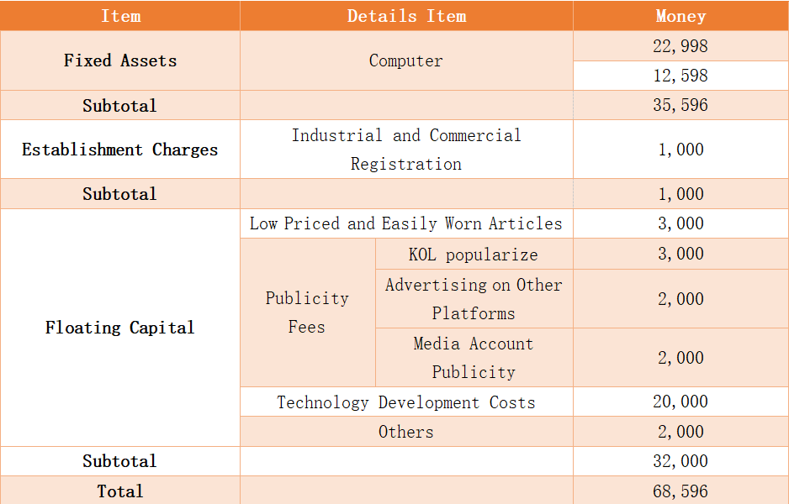
investment Forecast

Slide 24
Revenue projection
-- Mainly from third party advertisement placement revenue
-- Start advertising in the fourth quarter of the first year
-- Full-screen ads and horizontal ads
-- The costs will be negotiated with third parties
User volume projection
-- Increase year on year from the time the software is officially launched
-- Expected to have a total of 60,000 registered users after three years

Slide 25
Chapter 6
Team Structure

Slide 26
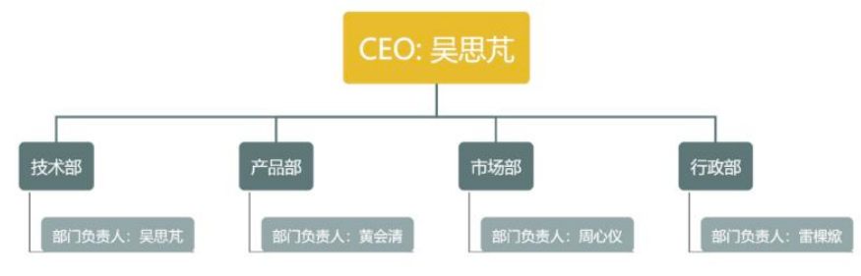
Team Structure

Slide 27
Thanks for
listening!
Group member: SIPENG WU
KEXIN LEI
XINYI ZHOU
HUIQING HUANG

